Slide 1
Project: Understanding New York Real Estate
Section 2: Drew Bertram, Harsheil Arora, Neha Gupta, Samineni Chandra Vadan, Suyash Sharma

Slide 2
Reinventing construction through productivity revolution
Productivity Problem - E&C sector
Core of the Problem
Solution
Productivity gap costs the global economy $1.63 trillion a year
Global Construction sector ($25/hr) versus Global economy (($37/hr)
Annual increase in Labor productivity:
Construction sector - 1%
Global economy - 2.8%
Manufacturing - 3.6%
Construction firms and contractors are more focused on optimizing up-front pricing to maintain margins than measuring and improving productivity
Inexperienced owners and buyers find it difficult to navigate an opaque marketplace
Increase in market transparency → Data-driven insights that helps firms offer more standardized products at lower price points
Firms can focus more on improving supply chain, engineering practices, onsite execution, automation, re-skilling the workforce, etc. which will address the productivity issue

Slide 3
Overview of Dataset
84548 Records
Data Includes
Location Information
Building Class as defined for NYC (Residential / Industrial / etc)
Tax Class
Number of Residential and Commercial Units
The total number of units
The Gross Sq Feet and Land Sq Feet
The Year it was Built
The Year it was Sold
The Sale Price of the Property

Slide 4
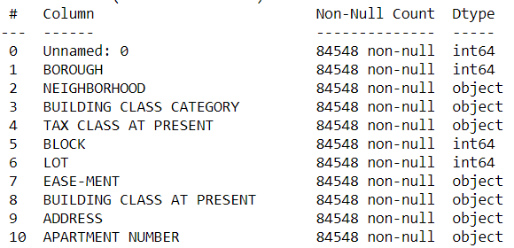
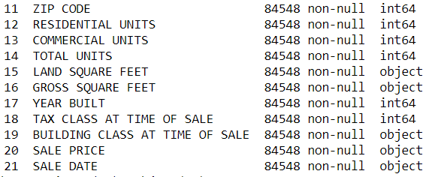
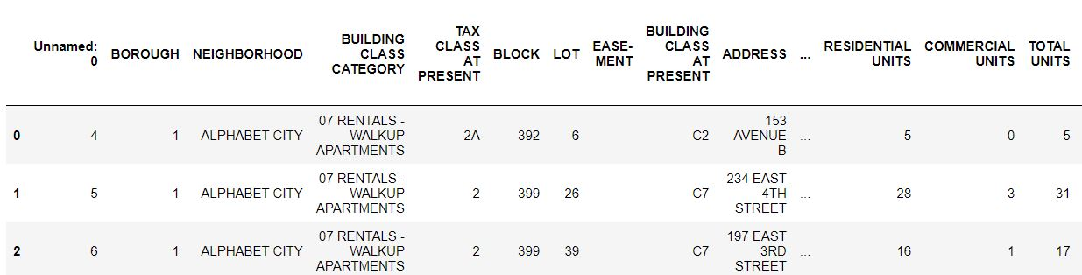
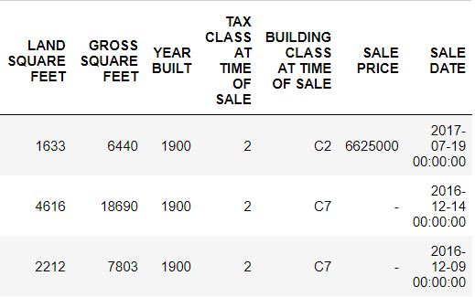
Problems in UnClean Data: Part 1
Wrong Data Types
Data to be Dropped

Slide 5
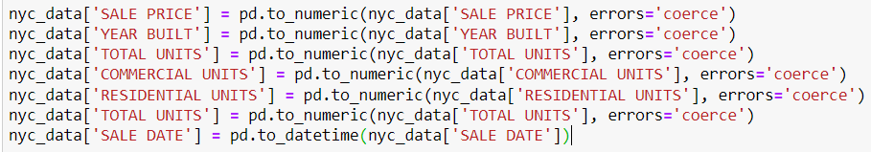

Cleaning the Data Part 1: Data Types
Assign appropriate data types to the columns
Replacing 0 values for Area (which are impossible) with NA
Replacing Numerical Values with descriptions for better understanding

Slide 6
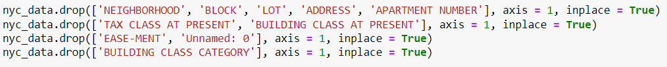
Cleaning the Data Part 2: Dropping Data We
Don’t Need
Very Specific Address Information is not necessary for our Analysis. We only need the general area of the property.
Removing Empty or Irrelevant Data
Instead of Building Class Category, we defined a broader building class which we will be using for our analysis. (e.g. A1, A2, A3 → A)
Since we are analyzing sale prices, we only need these classes at time of sale.

Slide 7
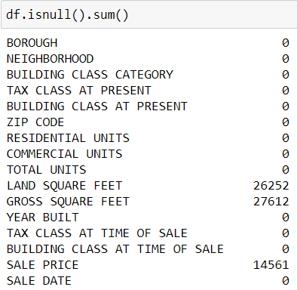
Problems in UnClean Data: Part 2
The columns need to be assigned to the correct data type:
Numerical Values ⇒ int64
Dates ⇒ datetime64
These Null Values had to be imputed
There are extra columns that we will not need for analysis:
Easement (Has no Data)
Unnamed (Do not know what it is)
Block, Lot, Address, Apt. Number (The specific address is not needed just the general area)
These Null Values had to be dropped because Sale Price is the Dependent Variable and the most important feature for Analysis

Slide 8

Cleaning the Data Part 3: Dealing with Null Values and
Outliers in Sales Price
Removing the Null Values because it is the dependent variable we are trying to analyze
Removing The Outliers:
The Lower Limit (18%) is sales price that is 0 or close to 0
which usually results from inheritance
The Upper Limit (99%) is sales price that is way above the
Normal. While these exist in Super
Luxury Properties, they will
negatively affect our analysis.

Slide 9
Cleaning the Data Part 4: Dealing with Null Values in
Land & Gross Square Feet
Properties in the same building class (same type of building) & in the same Borough are likely to have similar Area. So we fill na values with mean area of their groups
Group by just General Class and Borough and fill in mean areas.
There are still null values after this which we fill with grouping by just General Building Class
Due to lack of combinations of Building class and Boroughs, some means do not compute. So NA values still exist. We derive a general building class from the more specific ones

Slide 10
Deriving More Data for Analysis Part 1:
Keys for Building Class Codes
The Building Class and Broad Building Class are just alphanumeric values and we don’t know what they mean:
The Building Class Description adds a key for Building Class; (C2 = 5 to 6 Families)
The Broad Building Class Description adds a key for Broad Building Class; (C = 3 or More Family Homes and Walk Ups

Slide 11
Deriving More Data for Analysis Part 2:
Age of Properties
We have the Date of Sale and the Year the Property was Built so we can derive the Age of the Building

Slide 12
Deriving More Data for Analysis Part 3:
Standardizing Sale Price
The Sale Price has a large variance depending on Building Class, Number of Units, Age, Size, etc
We Standardize Sale Price in accordance with Size because size is affected by Number of Units and Building Class
Basing our analysis on Sale Price per unit area makes more sense to draw a comparative picture

Slide 13
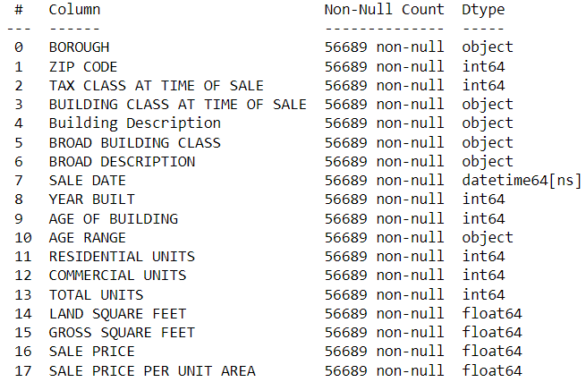
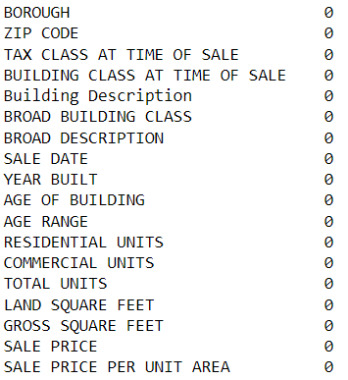

Organized and Cleaned Data
Appropriate Data Types
No Null Values
56,689 Records Left After Cleaning

Slide 14
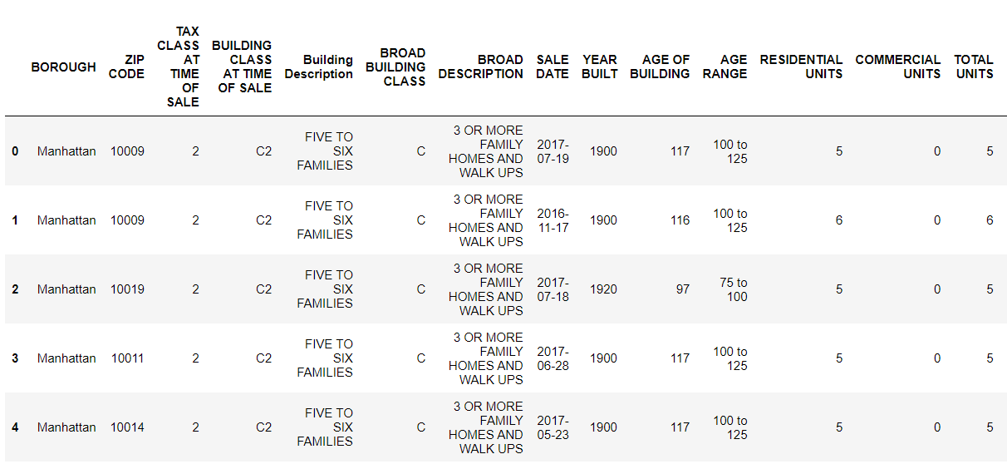
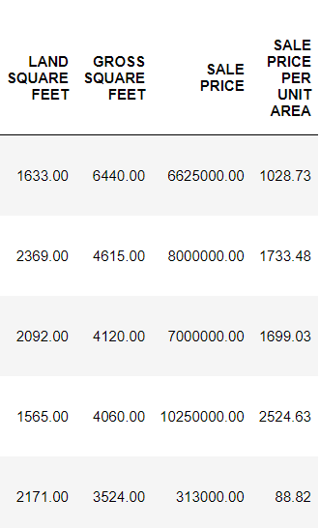
Organized and Cleaned Data
Added Data
Modified Data
Deleted Data between Columns

Slide 15
Exploratory Data Analysis
Now that the data is ready, we will delve into analysis. The approach we are taking is:
We are a consulting firm and our client is a real estate investor looking to invest in New York Properties.
A broad idea of real estate in NY
The types of buildings that the client is interested in
Providing a comprehensive estimation of the Sales Price for a given type of property

Slide 16
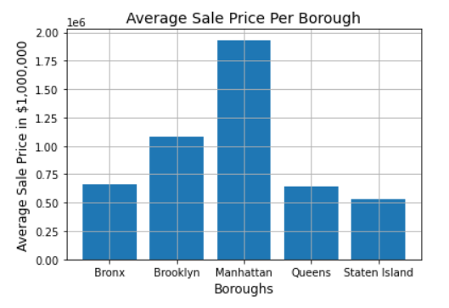
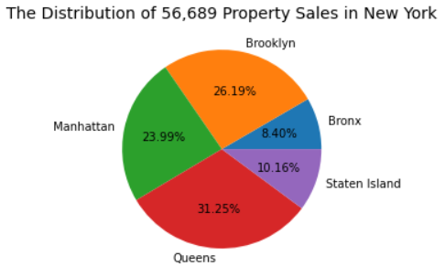
EDA Part 1
A Broad Idea of New York Real Estate

Slide 17
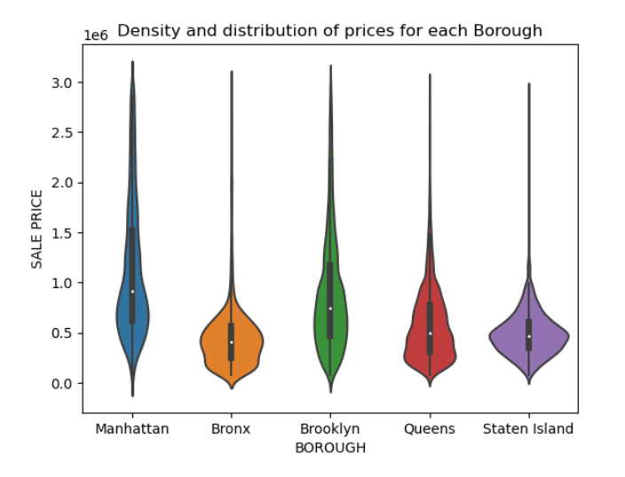
EDA Part 2
Density and Distribution of prices for each Borough
Right skewed price distribution for all Boroughs
Manhattan & Brooklyn have the maximum variation in Sale Price
Variation in sale price of Bronx and Staten Island are similar

Slide 18
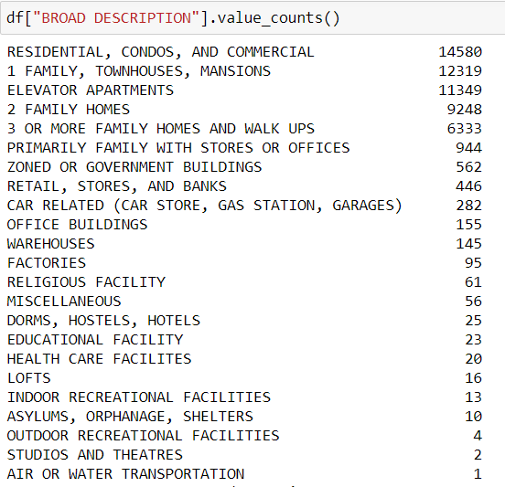
EDA Part 3
Important Building Classes with sufficient records for further analysis
Building classes most relevant from a commercial angle.
Analysis will be inaccurate or not in line with real situation.
(Less than 1,000)

Slide 19
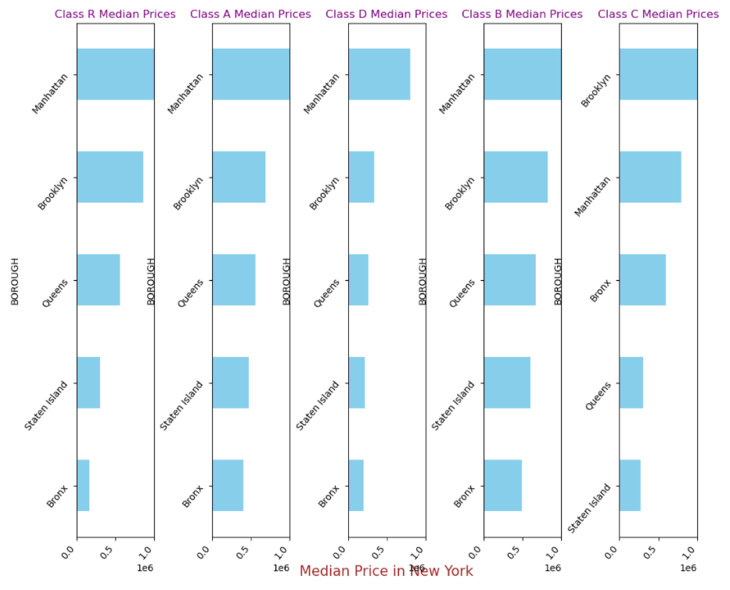
EDA Part 4
Variation of Median Sale Price in Identified Building Classes across Boroughs
Key:
R: Residential, Condos, & Commercial
A: 1 Family Homes, Townhouses, & Mansions
B: 2 Family Homes
C: 3 or More Family Homes and Walk Ups
D: Elevator Apartments

Slide 20
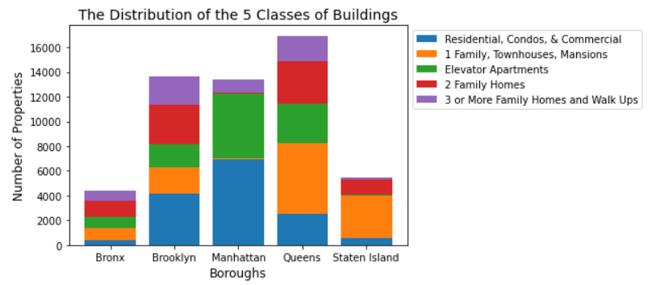
EDA Part 5
Distribution of Identified Building Classes
The Building Classes that the firm would be interested in are:
Residential, Condos, & Commercial
Elevator Apartments
3 or More Family Homes and Walk Ups
This is because 1 and 2 family homes are usually not in the rental market and cannot be sold as individual condos for profit
Considering the 3 Building Classes of interest; Staten Island barely has any properties of interest. Bronx has a few, a majority are concentrated in Manhattan, Queens, and Brooklyn

Slide 21
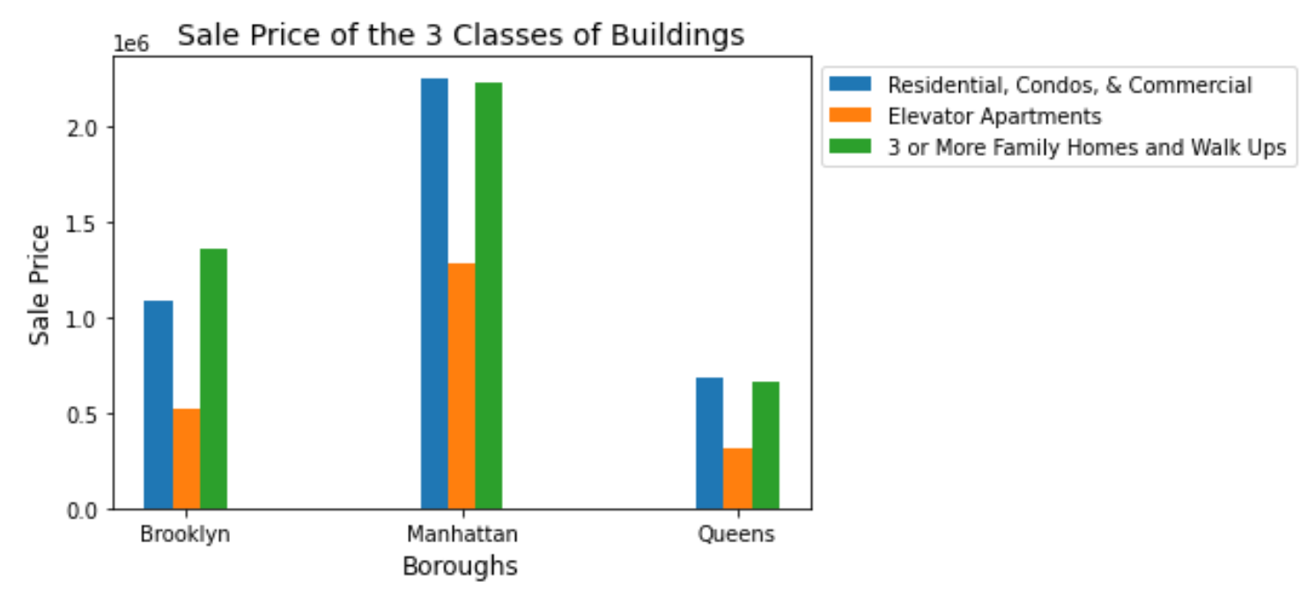
EDA Part 6
Comparison of Sale Price for Identified Building Classes

Slide 22
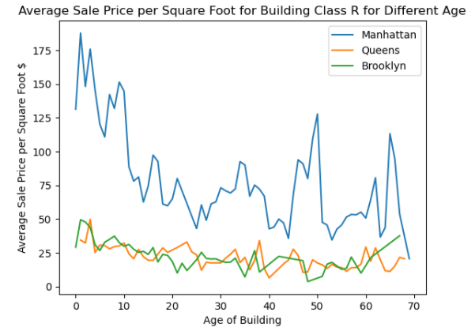
EDA Part 7
Sale Price versus Age of Building

Slide 23
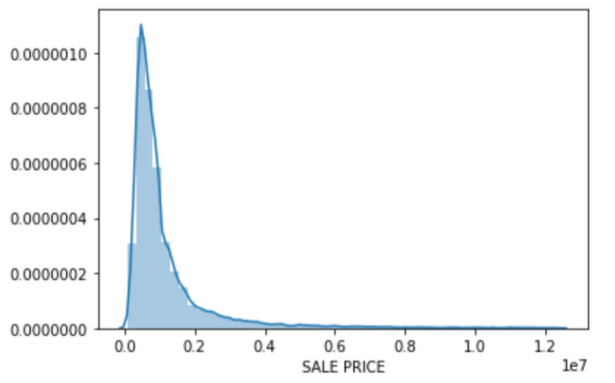
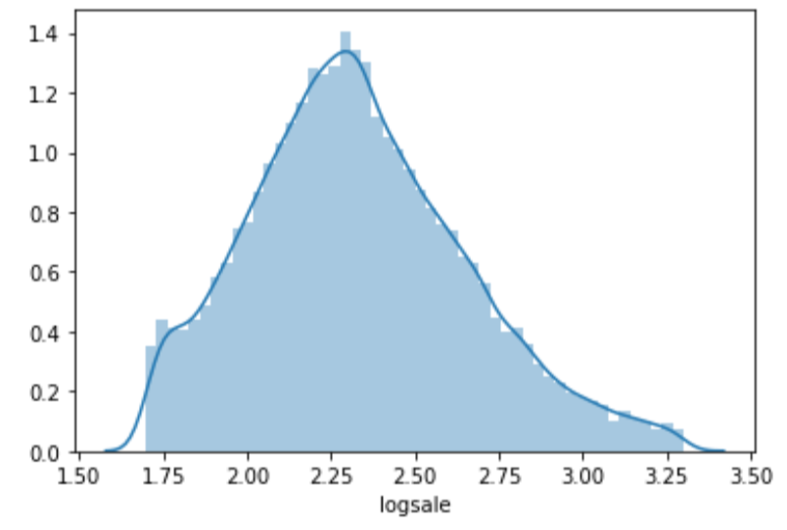
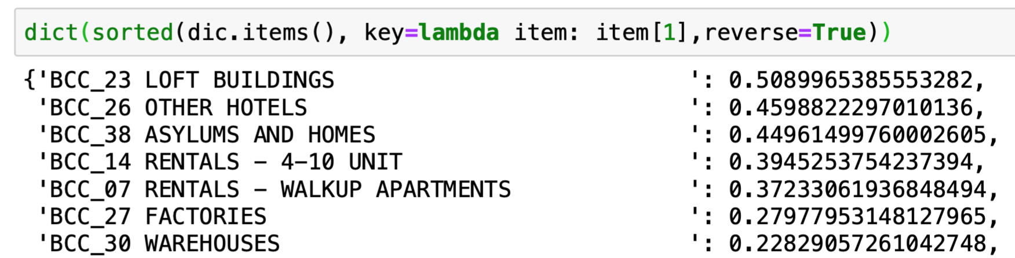
Feature Importance
REGRESSION MODEL
Log Transformation

Slide 24
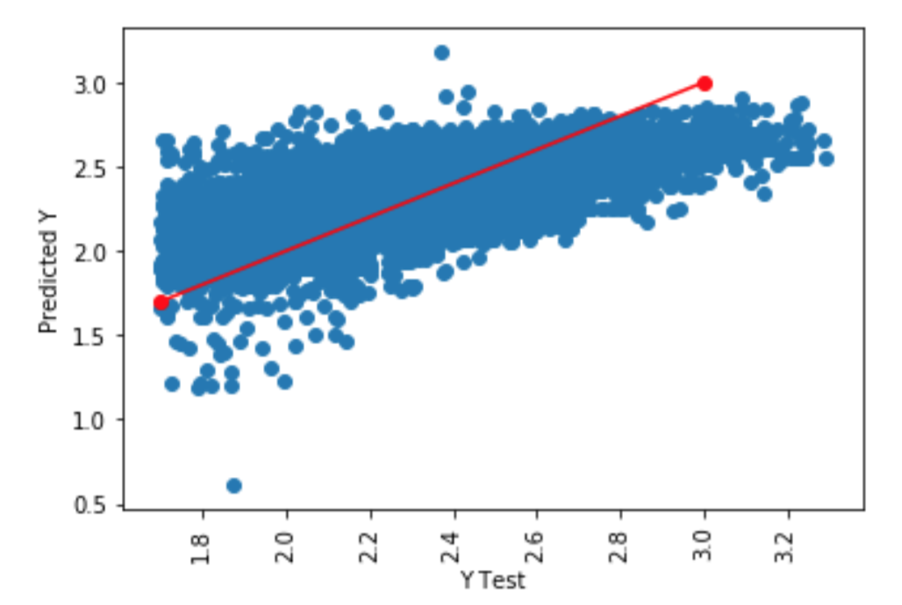
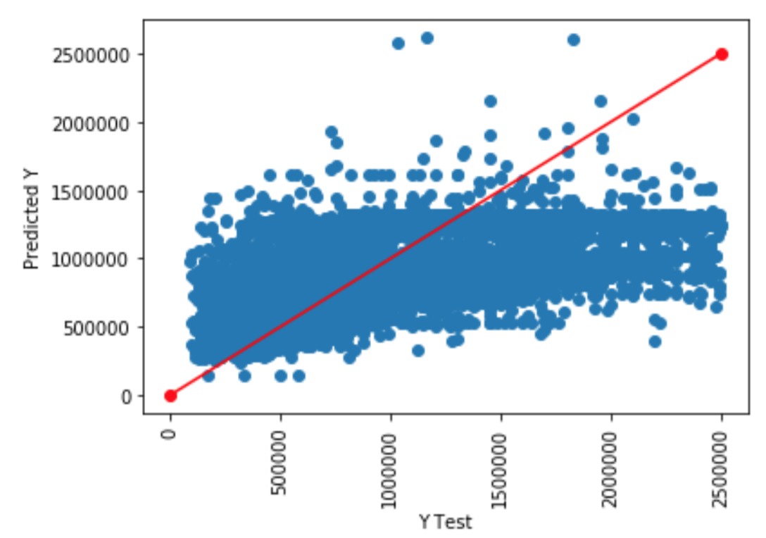
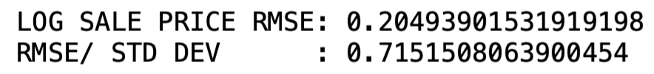

MODEL COMPARISON
LOG SALE PRICE
SALE PRICE

Slide 25
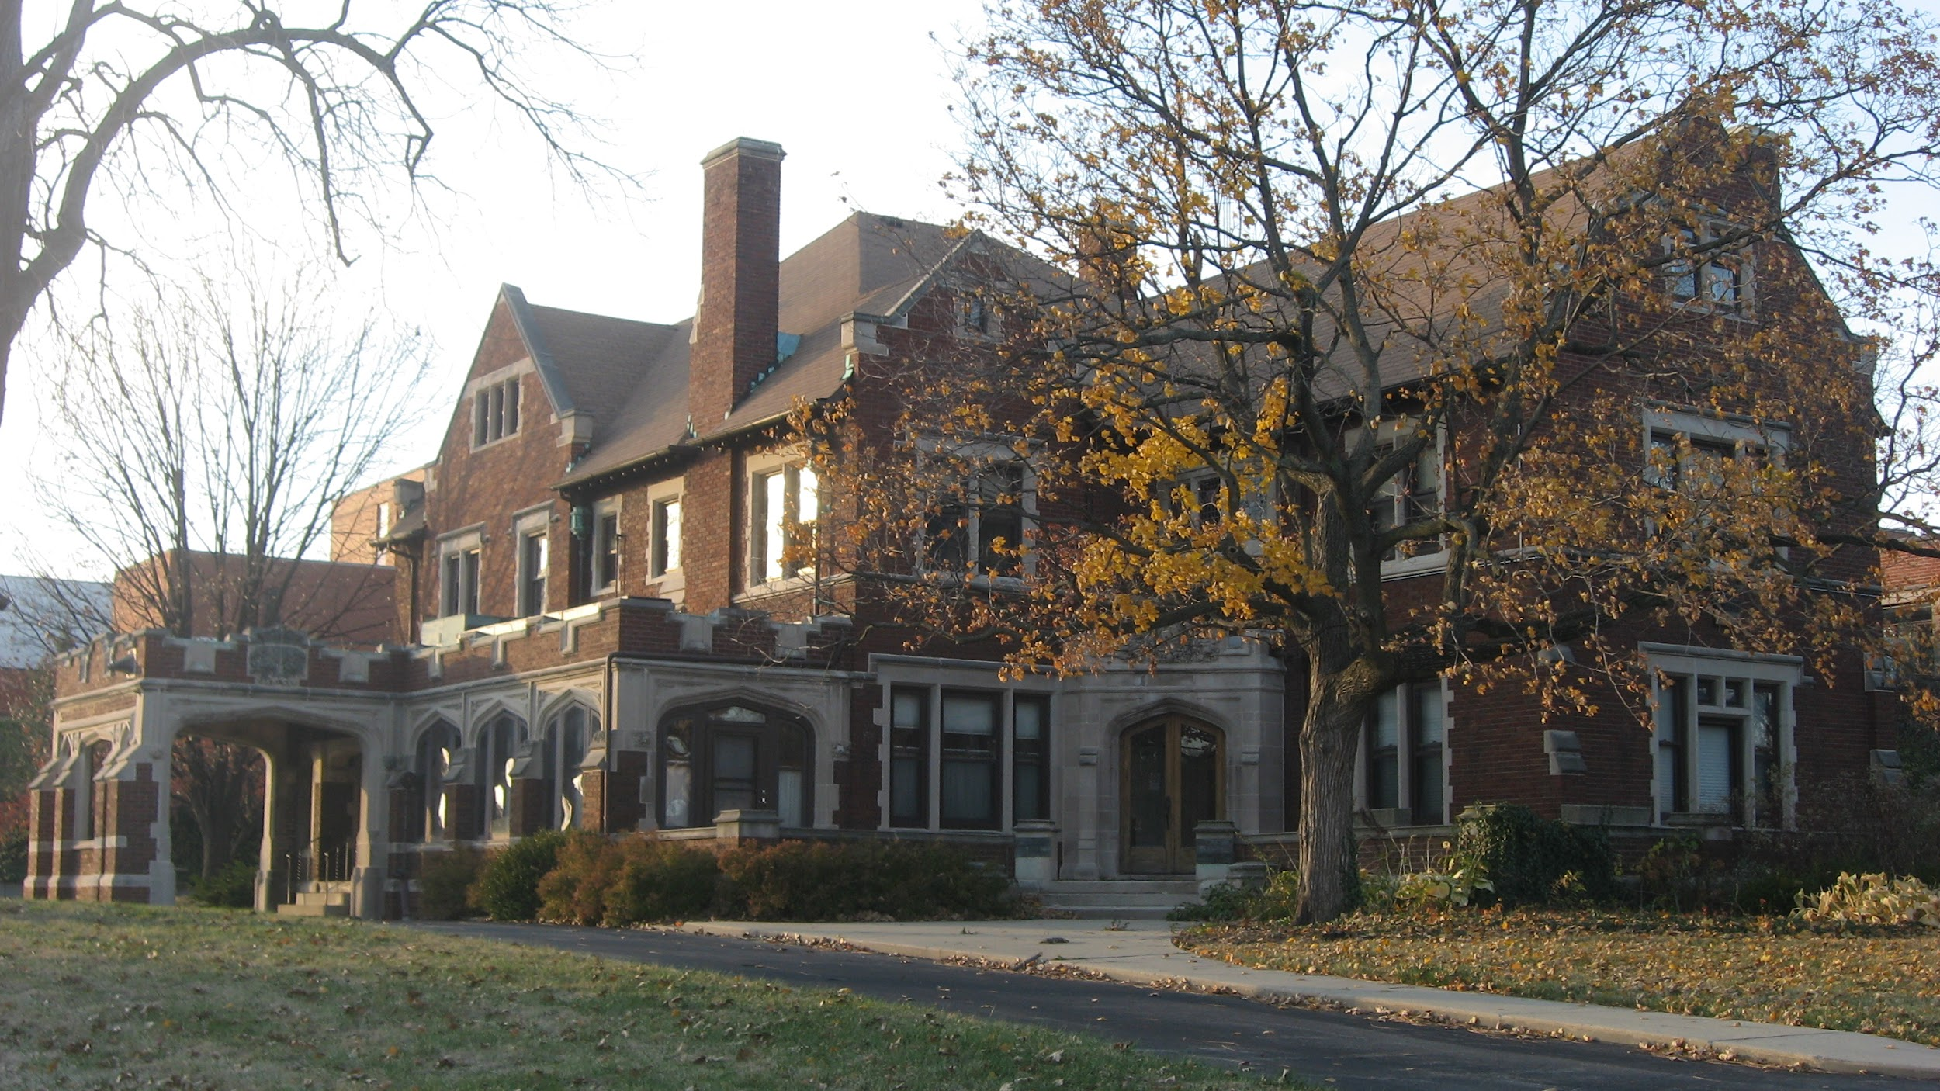

Importance of Features based on Regression Analysis
Borough and Building class types are playing key role in determining the sale-price of a property
Though we have area as a variable, since it varies a lot across Boroughs, land area or gross area do not come to be significant
Single unit with high gross area but low sale price
Single unit properties with low gross area and high sale price
Notes:
Reference of the pictures : Google Images

Slide 26
Predictive Analytics can drive smarter engineering and construction decisions
Analysis gives us fair understanding of new york real estate market and the important price predictors
Model is able to predict the price of the property within one standard deviation
The prediction helps our clients in feasibility analysis and increase their productivity as a by-product
Firms can focus on productivity issues than optimizing prices; it gets resolved as a by-product
The scope for the project is high as any seller or buyer of property in New York can get a fair estimate of sale price for the property they are interested in

